Slide 1

Statistics for spatio - temporal data
Student: Duc Duong (871492)
Instructor: Prof. Carlo Gaetan

Slide 2
Content
1. Motivation for studying the problem
2. A description of data
3. Identify possible trends and seasonality. Check the relevant between temperature and rainfall
4. Check the stationary and evaluate by ARIMA model
5. Forecast some periods
6. Conclusion

Slide 3
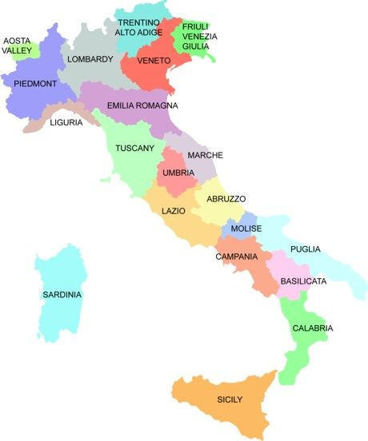
1. Motivation for studying the problem
(Source: https://www.pinterest.com/pin/274297433537401833/)

Slide 4
2. A description of data
the record of the monthly average temperature (by Celsius degree) and rainfall (by millimeter) in Italy in 115 years (from 01/1901 to 12/2015)
Source: [Climate change knowledge portal]

Slide 5
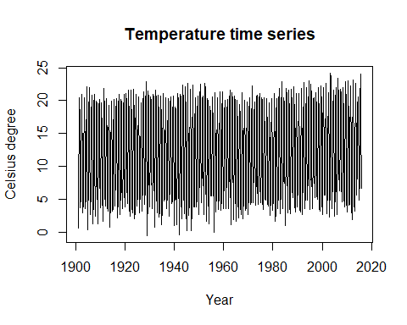
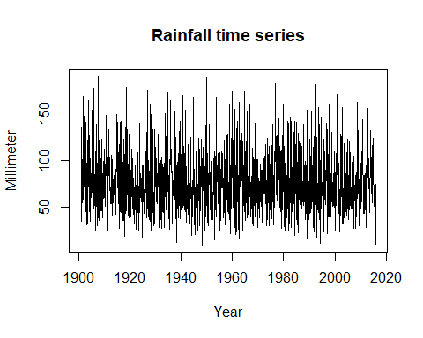
2. A description of data

Slide 6
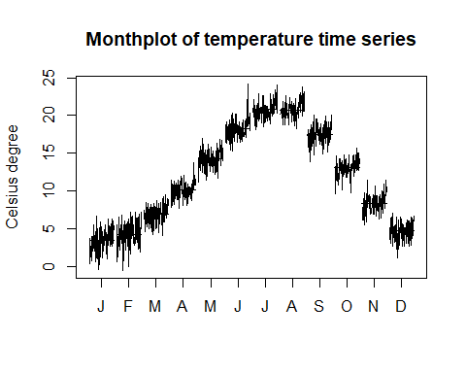
3. Identify possible trends and seasonality

Slide 7
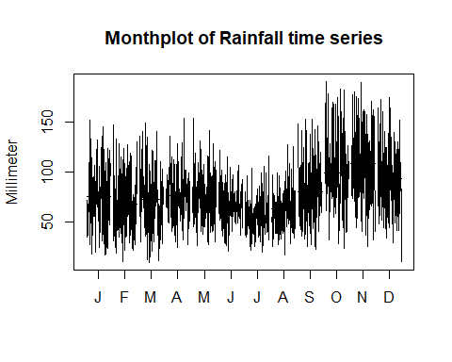
3. Identify possible trends and seasonality

Slide 8
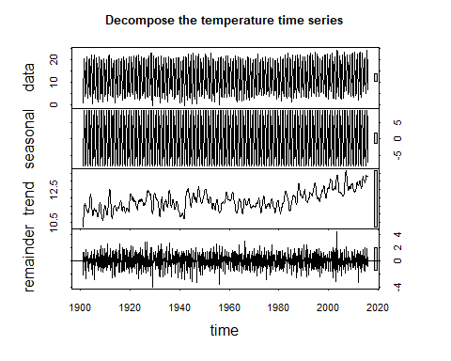
3. Identify possible trends and seasonality

Slide 9
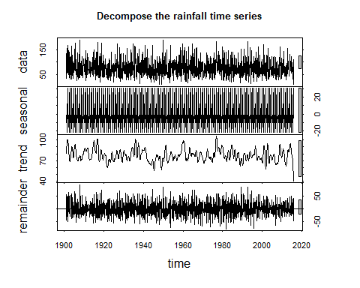
3. Identify possible trends and seasonality

Slide 10
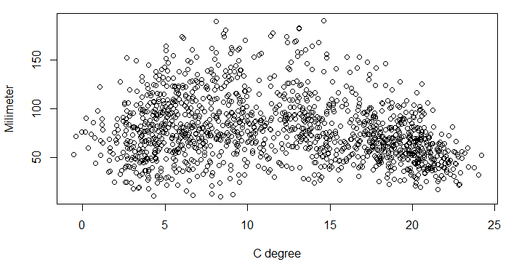
Check the relevant between temperature and rainfall
Based on the difference between the seasonality and the trend
Cor = -0.2
There is no relationship between the temperature and the rainfall

Slide 11
4. Check the stationary and evaluate by ARIMA model
## Augmented Dickey-Fuller Test ## data: temp.ts ## Dickey-Fuller = -7.7423, Lag order = 11, p-value = 0.01 ## alternative hypothesis: stationary
## Augmented Dickey-Fuller Test ## data: rain.ts ## Dickey-Fuller = -10.387, Lag order = 11, p-value = 0.01 ## alternative hypothesis: stationary

Slide 12
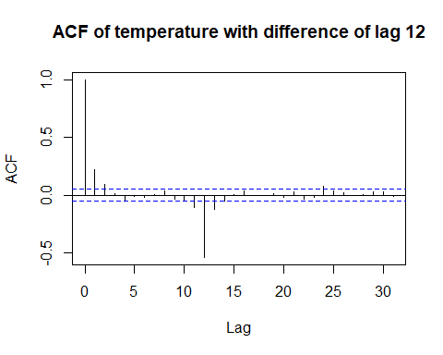
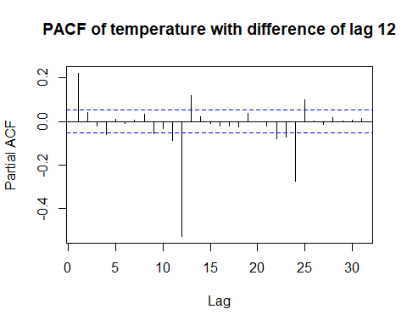

Slide 13
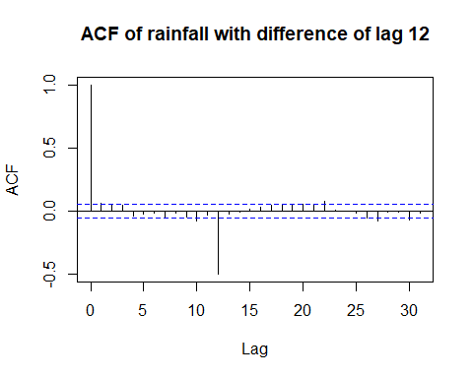
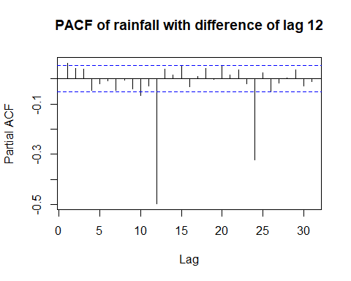

Slide 14
Data | Model | AIC | BIC
Temperature | ARIMA (1,0,0)×(0,1,1)[12] | 4269.819 | 4285.482
 | ARIMA (1,0,0)×(1,1,1)[12 | 4270.098 | 4290.982
Rainfall | ARIMA (1,0,0)×(0,1,1)[12] | 13101.62 | 13122.5
 | ARIMA (2,0,0)×(0,1,1)[12] | 13103.62 | 13129.72

Slide 15
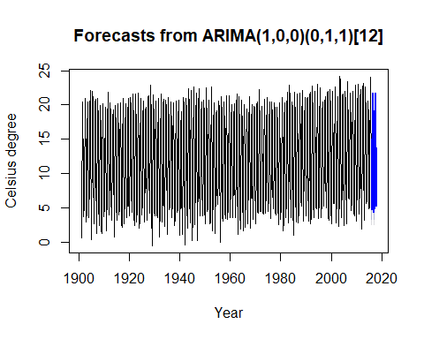
5. Forecast some period

Slide 16
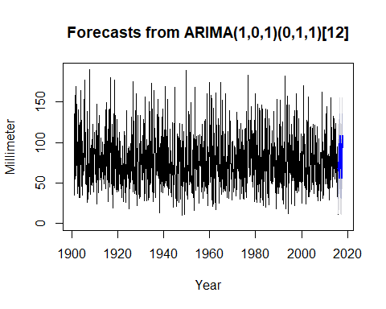
5. Forecast some period

Slide 17
6. Conclusion
Both time series have seasonality, it fits with our knowledge about climate.
In more than 100 years in Italy, the rainfall still remains while the temperature slightly increases. It means that the environment is hotter and hotter.

Slide 18
Thank you!
Q&A

